Slide 1
Things to Print
Add reflections on diversity
Print Math Essay
Print Program out
Print out pictures of History website
Print Elephanty

Slide 2
Diversity Project
Emelia Blankenship

Slide 3
Outline
Mobile Apps
English II
Chemistry
U.S. History
Fundamentals of Design

Slide 4
Mobile Apps
Created a mobile application that allows students to select their school/classes, then share the assigned homework, and see the homework that others have posted.
Block 1

Slide 5

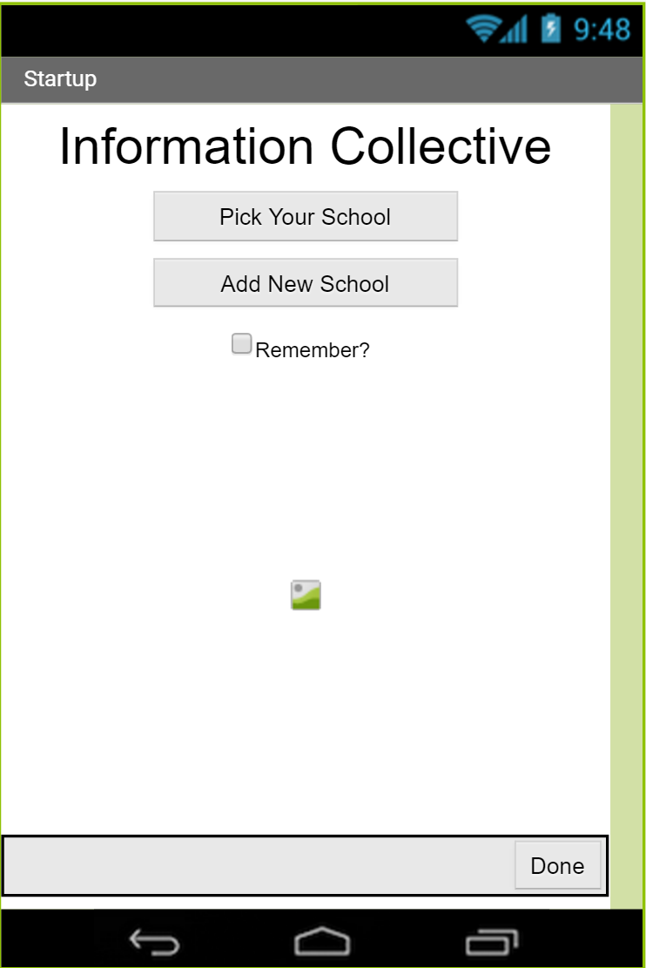
App #5: Information Collective
Developers: Emelia Blankenship & Hunter Harris
Problem: Students are constantly forgetting their homework, and school devices such as online planners are prone to errors.
Solution: Web of students contributing to a single database of all of the school’s classes, and their assignments. Select your school and the classes you are enrolled in to display the upcoming assignments and mark when you have completed them.
Diversity Statement: This app is diverse because it is applicable to every student in any school, and it is open to everyone.
Visuals are a work in progress

Slide 6
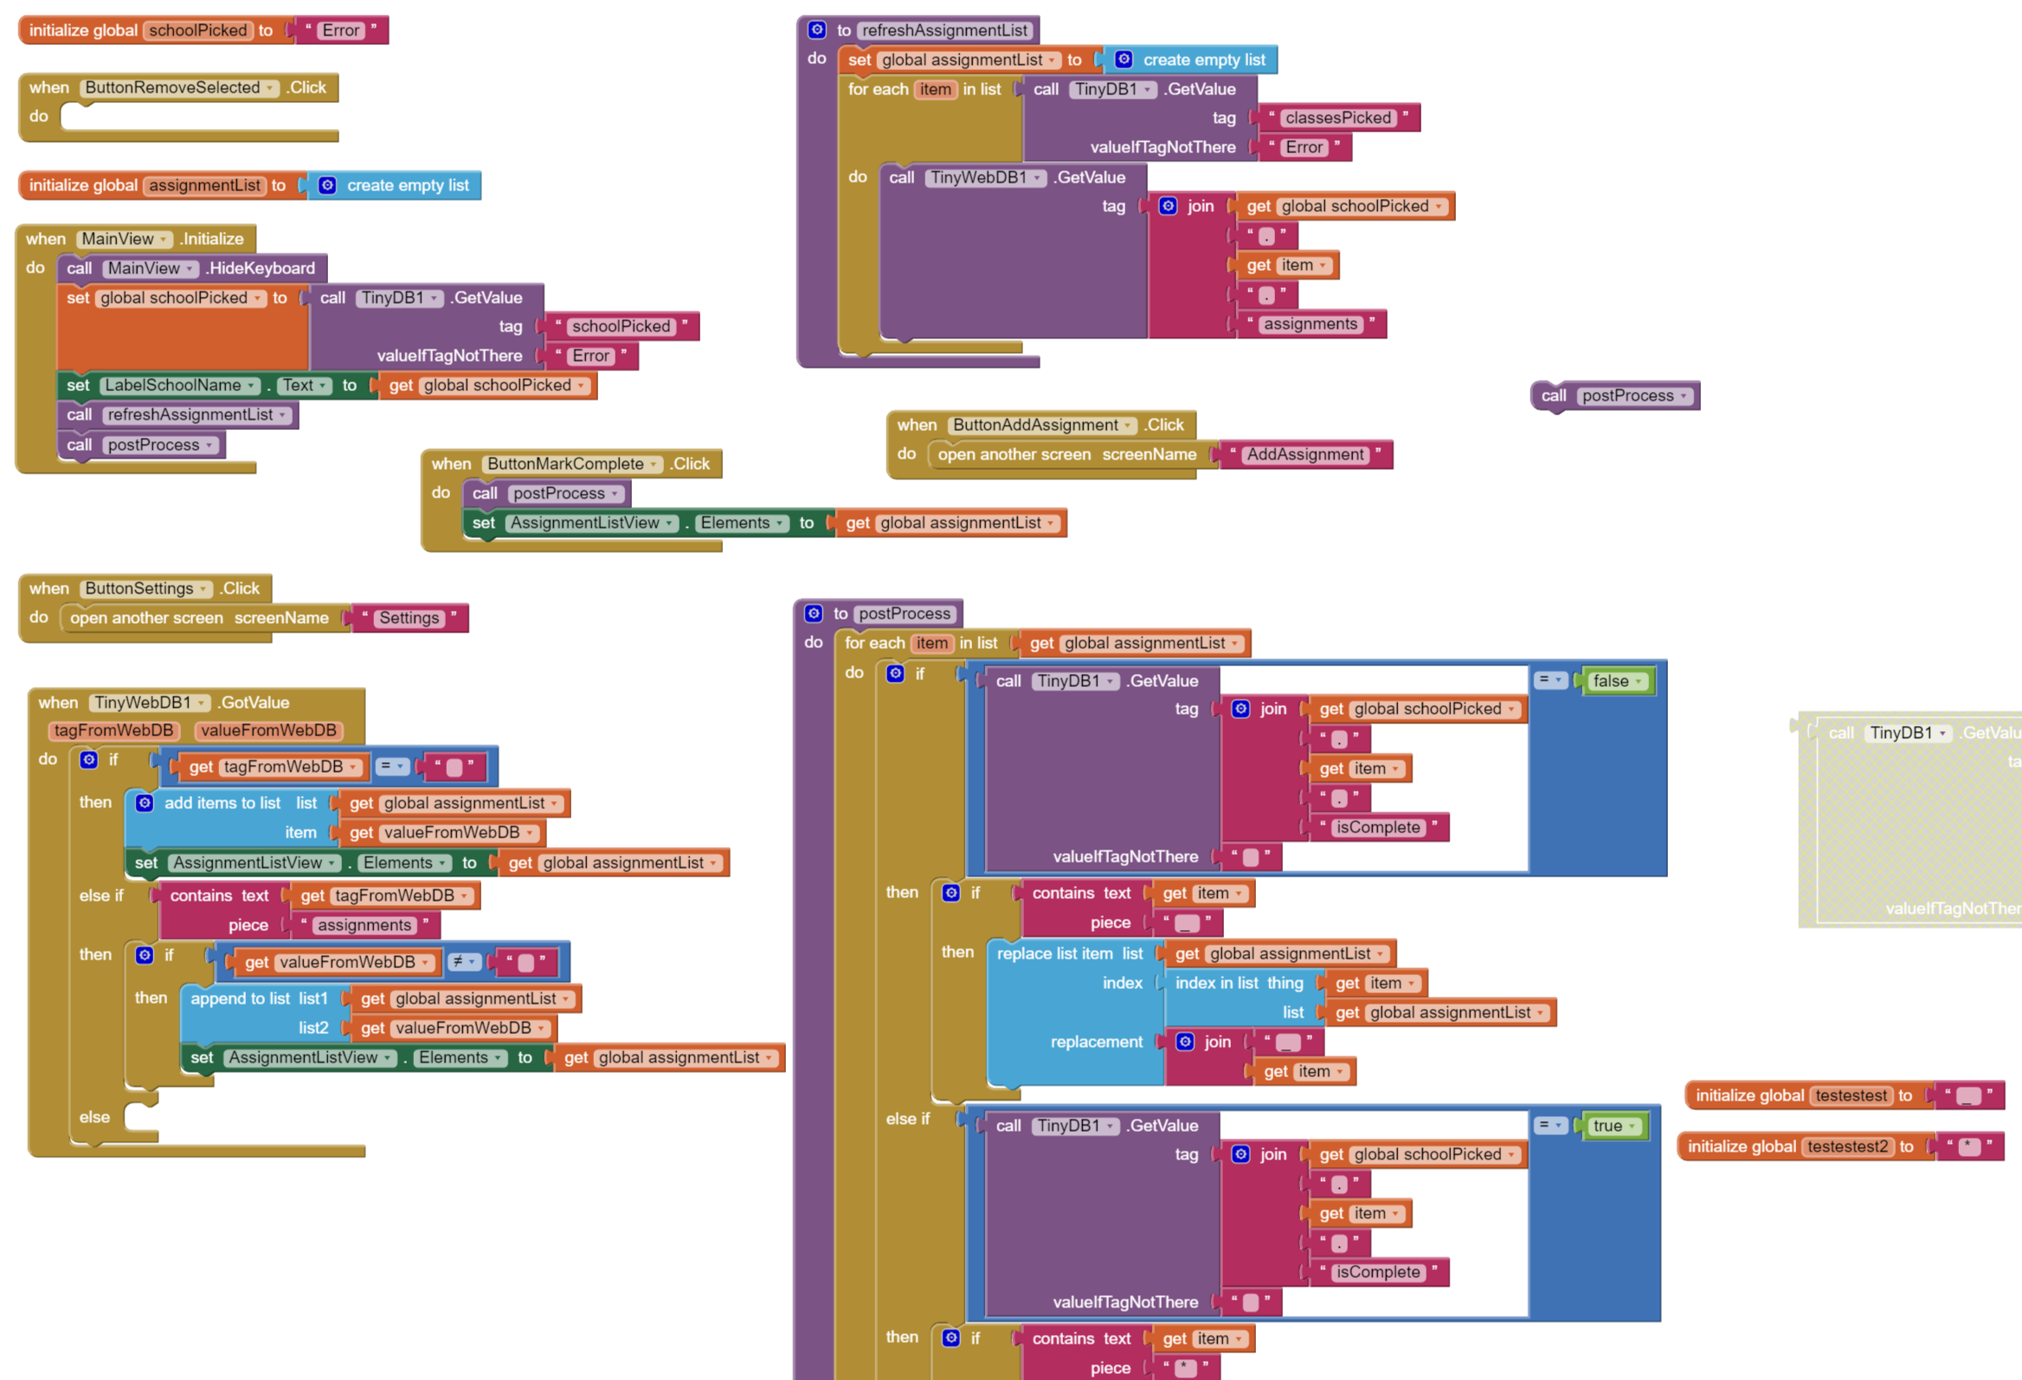
App #5: Information Collective Code

Slide 7
Growth
Collaboration
Diverse apps
Coding

Slide 8
English II
Learned about challenges and benefits of diversity and compared people from our biographies to characters in Macbeth.
Block 2

Slide 9
Diversity Project
English II Honors
Ms. Mullen-Barnett
1/11/16
Nathaniel Rivera, Andres Morales-Merced,
Emelia Blankenship, Jordan Charlow

Slide 10
What are the challenges and benefits of considering diverse differences and contrasts in writing and in life?
Notes:
Emelia

Slide 11
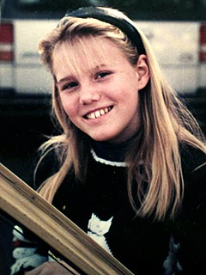
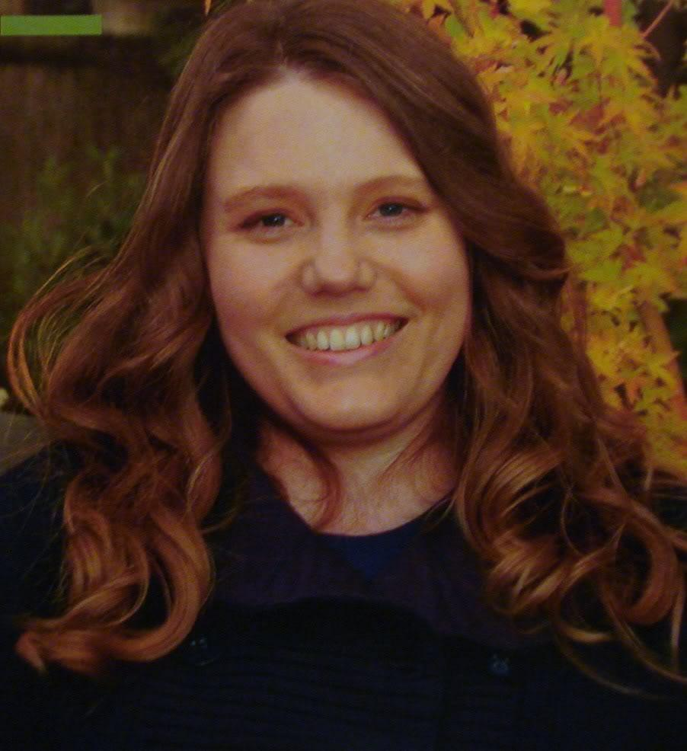
Emelia: Duncan / Jaycee
Duncan and Jaycee both suffered from abuse, though Duncan’s was entirely physical and Jaycees was primarily mental.
Duncan:
Killed using physical means by someone he had trusted.
Jaycee:
Jaycee was damaged mentally for the most part, though she did suffer from short term physical abuse.
“I’ve learned that verbal abuse can be just as damaging as physical abuse, and take longer to heal from”
-Jaycee Dugard
Notes:
This just explains my slide, not diversity.

Slide 12
Real Life Challenges of Diversity
In real life, challenges of Diversity deal with heavy racism and gender equality issues.
Everyone is diverse and unique in their own way and most people don’t see that and think everyone should be the same.
Notes:
Andres

Slide 13
Real Life Benefits of Diversity
No matter how different people are, you can still find similarities in interesting and specific ways that connect people.
New insights from parties of different backgrounds and experiences makes a path for better ideas and choices.
Notes:
Nathan

Slide 14
“We may have all come on different ships, but we’re in the same boat now.”
Martin Luther King Jr.
Notes:
All came from different places but now we’re here. Jordan
Started from the bottom now we here

Slide 15
Growth
Connections among characters (Diversity)
Connecting present to past / fiction to nonfiction
Collaboration

Slide 16
Pre-Calculus
Wrote a research paper on mathematician Grace Hopper
Block 4

Slide 17
Growth
Diversity among mathematicians
Writing
Connecting math to the real world

Slide 18
Chemistry
Wrote a program in python that gives information about two elements and compares them, showing how diverse elements can be.
Block 5

Slide 19
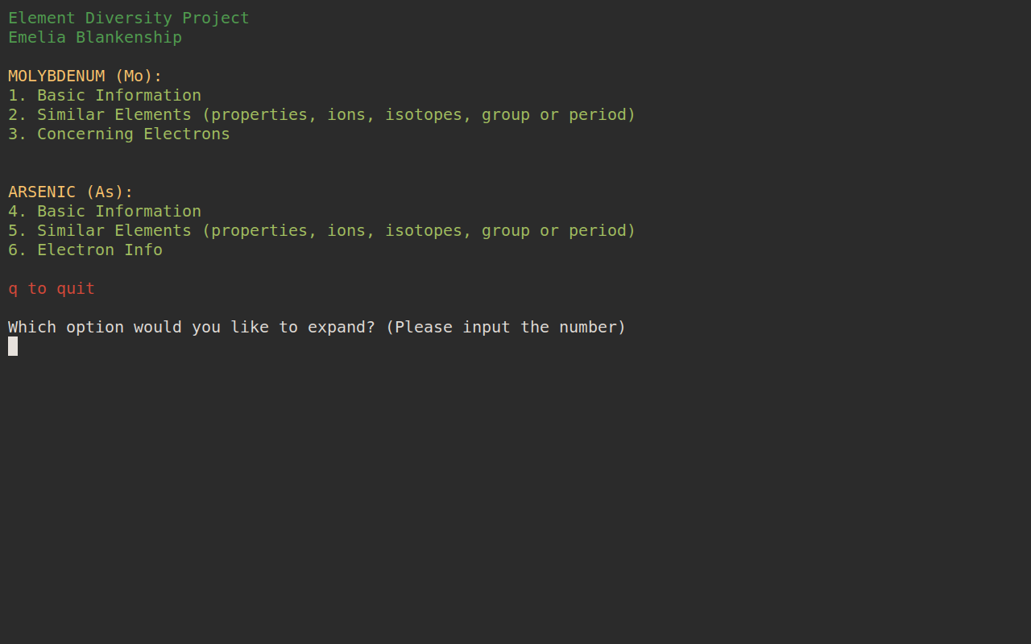

Slide 20
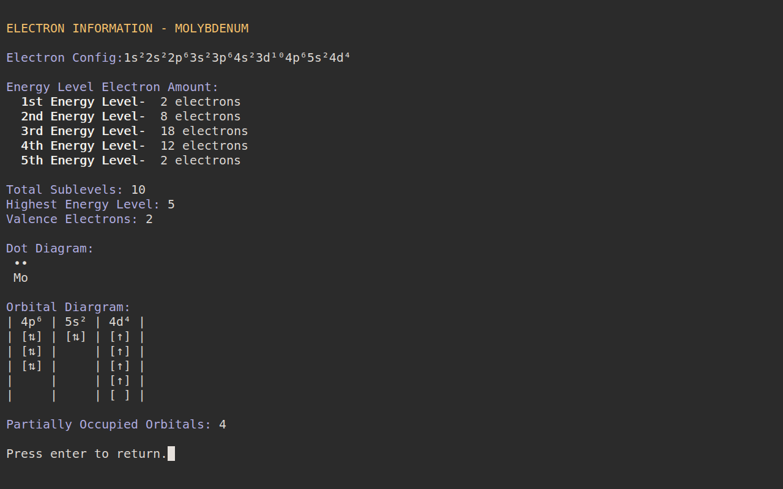

Slide 21
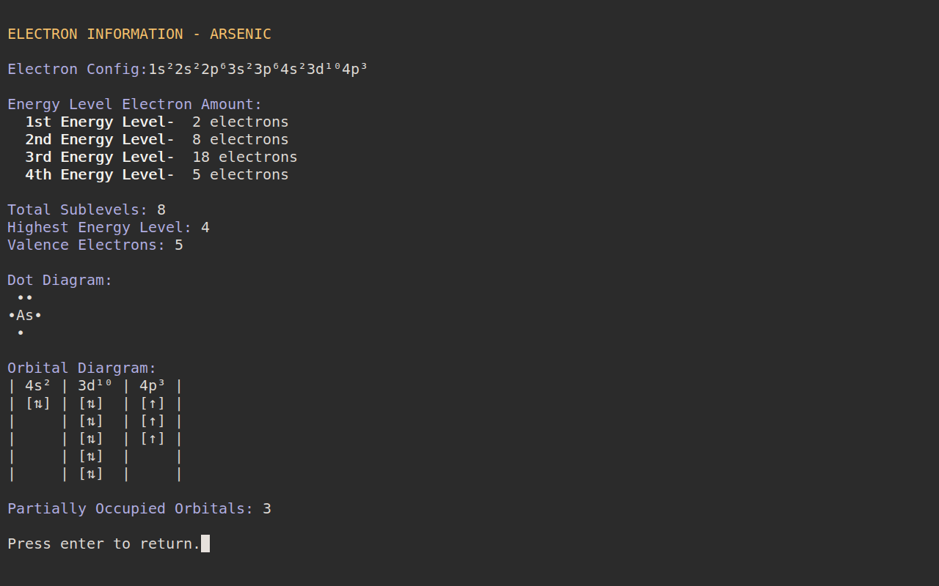

Slide 22
Growth
Diversity among the elements
Diversity applies to everything
Coding
Reading periodic table

Slide 23
U.S. History
Created a website that provides information on Western Expansion, also known as Manifest Destiny.
Block 6

Slide 24
http://egb.westexp.jad340.com/

Slide 25
Growth
Peer code
HTML/CSS
Views/Opinions/Positions

Slide 26
Fundamentals of Design
Planned an event to celebrate African History Month and inform the public about the African culture. Through tea.
Block 7

Slide 27
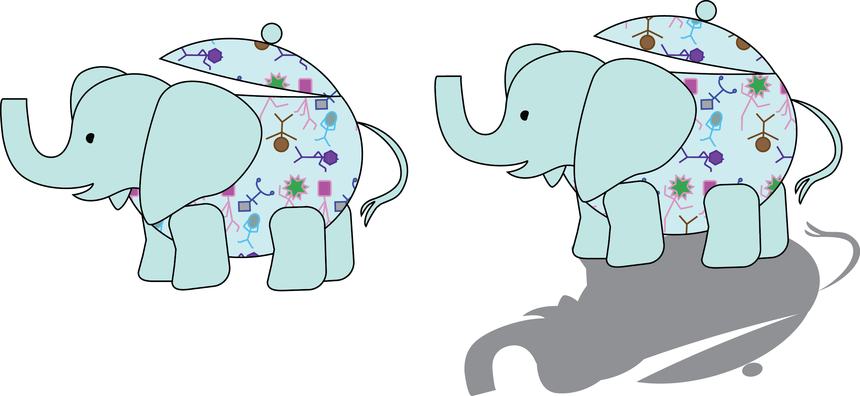
Elephanty
Eva Hallstead-Williams and Emelia Blankenship
Notes:
both

Slide 28
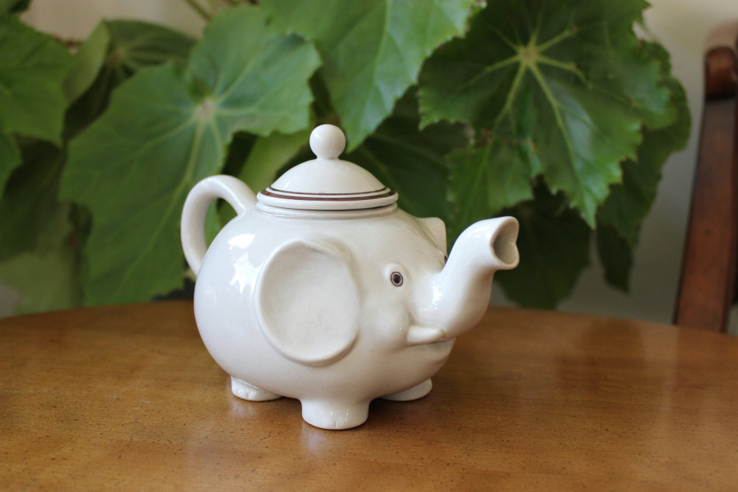
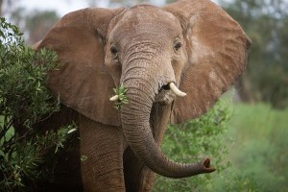

What Is Elephanty?
Our mission is to bring classic English-American tea parties alive in the most pristine fashion, for the less privileged citizens of Africa, home of the African Elephant. This will happen through celebrating the diversity of African Americans, by holding events where learning about their culture is encouraged.
This month we will sponsor Black History Month.
Notes:
Emelia

Slide 29

Logo
Notes:
Eva

Slide 30
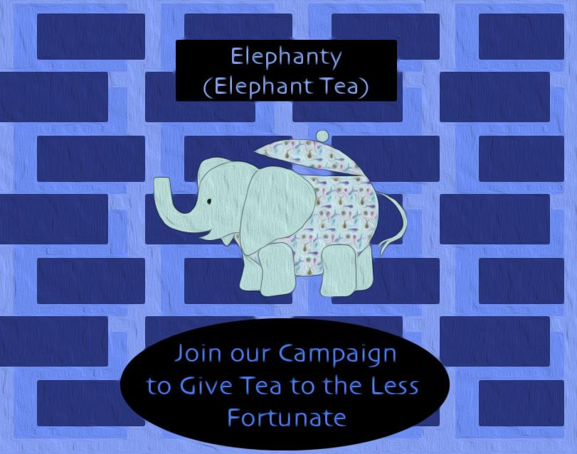
Notes:
Eva

Slide 31
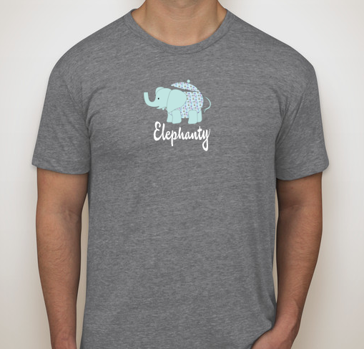
T-Shirt
Notes:
emelia

Slide 32

Give Away Item
Notes:
Emelia

Slide 33
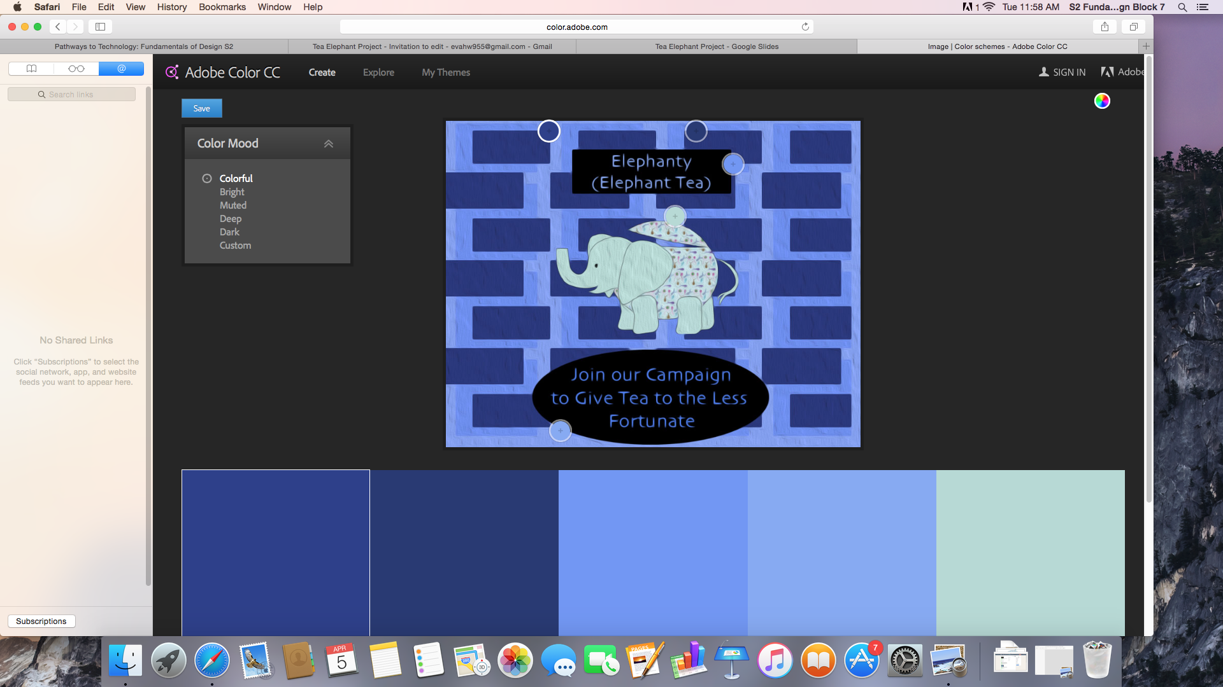
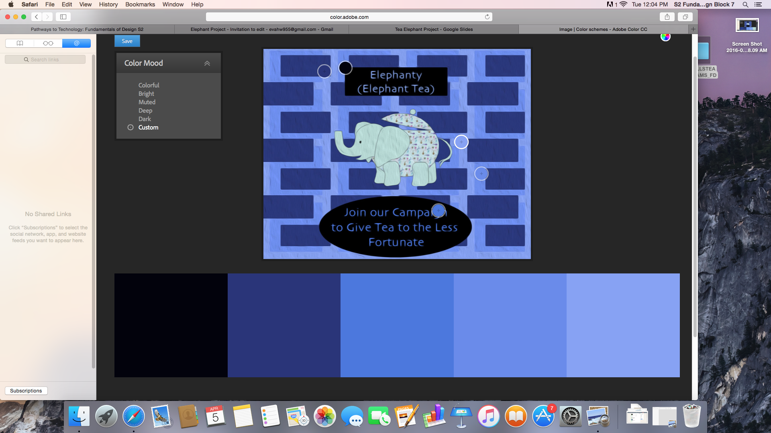
Color scheme
#2D3E8D
#2D3E8D
#7195F7
#86A9F5
#B7DAD6
#02020D
#29337B
#4A75E1
#6989EE
#86A1F7
Notes:
Eva

Slide 34

Web Page Banner
Notes:
Eva

Slide 35
Growth
Collaboration
Graphic Design/Adobe Illustrator

Slide 36
Diversity
I learned that diversity effects all subjects and all people and is unavoidable. The flow of new ideas and new insights can benefit any field of work and even everyday life as we solve problems.

Slide 37
Questions?

